Slide 1
Project overview
By
JAMUNA DEVI S
Data Analyst Intern

Slide 2
Table of Contents
Project 1 – Analysing Amazon Sales Data
Project 2 – Financial Analytics

Slide 3

01 - ANALYSING AMAZON SALES DATA

Slide 4
Introduction Problem Statement
Amazon is one of the leading E-commerce platform where users can buy millions of products from a lot of categories.
Sales Management has gained importance to meet increasing competition and the need for improved methods of distribution to reduce cost and to increase profits.
Sales Management today is the most important function in a commercial and business enterprise.

Slide 5
Objectives
To calculate total revenue, total profit, total cost and the total units sold.
To calculate the total number of orders and total number of items.
To find the total revenue by item type, Order priority and Sales channel.
To find month-wise total revenue, total profit and total cost.
To find number of units sold for each month.
To find number of units sold by country.
To find total profit by region.
To find top 5 profitable items.
To find which country has the least sales.

Slide 6
Data Collection
The Data has been collected in the form of a CSV file named “Amazon Sales Data.csv”.
The CSV file has the data of sales of products during the timespan of 2010 and 2017.

Slide 7
Data Cleaning
The data has no null values or blank fields.
Some values in ‘Order Date’ and ‘Ship Date’ columns are in text type. So we converted them to Date type using Excel.
Most of the values in ‘Total Revenue’, ‘Total Cost’ and ‘Total Profit’ columns are written with two decimal places, so we make sure that each value in these columns have two decimal places using Excel.

Slide 8
Data Visualization
The Data Visualization part are done using Power BI.
In Power BI, we used different types of visuals to get insights for the data.
Some visuals are line chart, column chart, pie chart, donut chart, card visuals and slicers etc.,

Slide 9
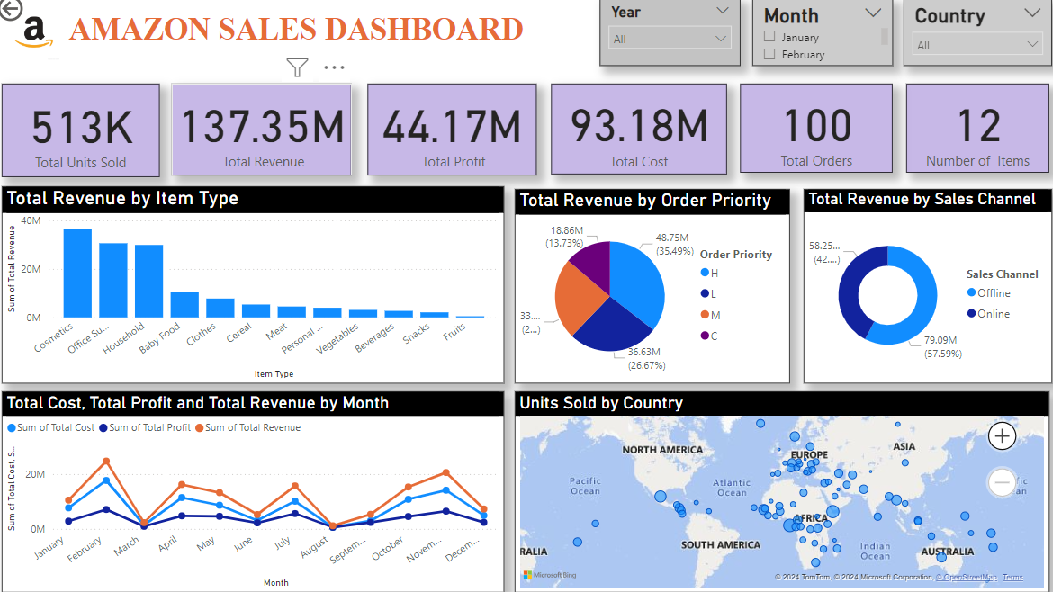

Slide 10
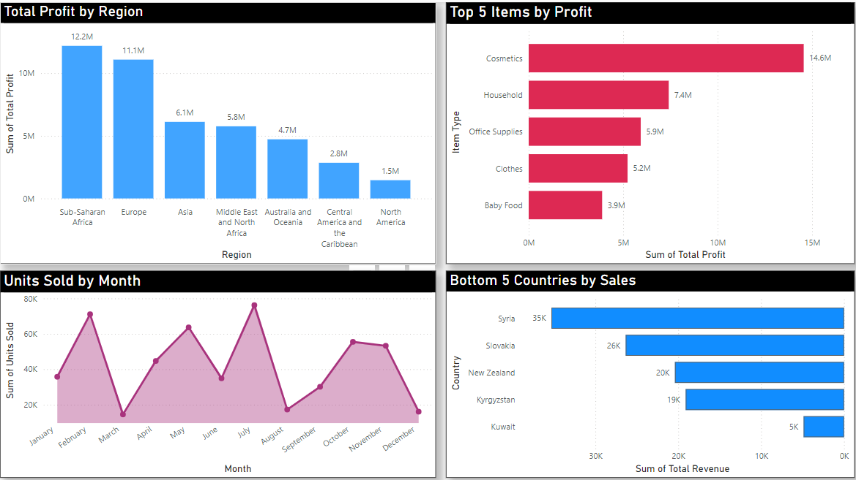

Slide 11
Insights
The total Revenue is $137.35 million out of which total profit is $44.17 million and total cost is $93.18 million.
The total number of orders is 100 and total number of items is 12.
“Cosmetics” products gave the highest revenue.
Majority of people still prefer “Offline Channel” for buying products.
The “H” order priority gave the highest sales, which means people need their products fast.
The Sub-Saharan Africa region has the highest profit.
The country “Kuwait” has the least sales.
The highest unit sold is in July month.

Slide 12

02 - FINANCIAL ANALYTICS

Slide 13
Introduction Problem Statement
Financial analysis is the process of evaluating businesses, projects, budgets, and other finance-related transactions to determine their performance and suitability.
It is crucial for a business to analyze the competition in order to survive. You have been assigned the task of analyzing the competition to help the management achieve better results. The dataset contains information about the market capitalization of the top 500 companies in India. Our goal id to identify key metrics and factors and to illustrate meaningful relationship between these attributes.

Slide 14
Objectives
To calculate total number of companies.
To calculate total market capital and total quarterly sales.
To find companies with highest quarterly sales.
To find companies with lowest quarterly sales.
To find companies with highest market capital.
To find companies with lowest market capital.
To analyze trend between market capital and quarterly sales for companies.

Slide 15
Data Collection
The Data has been collected in the form of a CSV file named “Financial Analytics Data.csv”.
The CSV file has the data ( Market capital and Quarterly Sales ) of top 500 companies.

Slide 16
Data Cleaning
Removed the S.No column as it is not required for analysis.
Some values of the column ‘Sales Qtr.-Crore’ are written on the adjacent column. I used paste special dialogue box and check the ‘skip blanks’ option to move those values to its original column using Excel.
Then I used power bi to deal with NaN values.

Slide 17
Data Visualization
The Data Visualization part are done using Power BI.
In Power BI, we used different types of visuals to get insights for the data.
Some visuals are line chart, column chart, pie chart, donut chart, card visuals etc.,

Slide 18
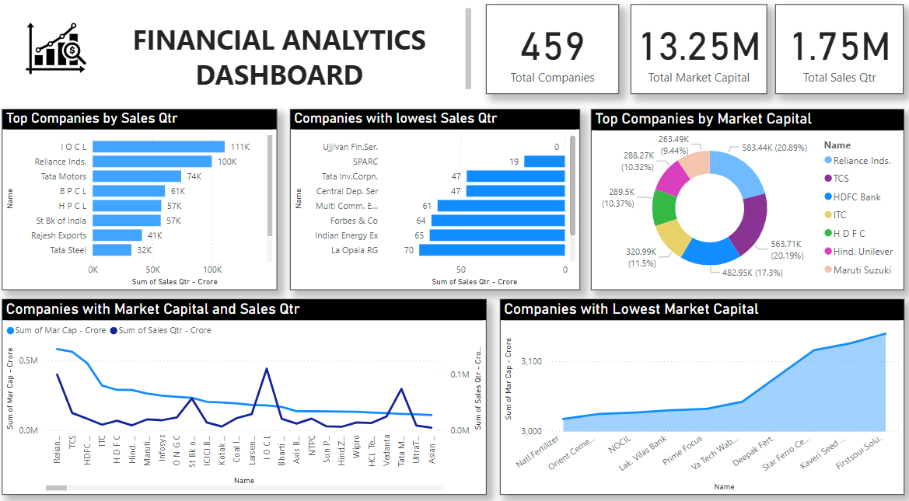

Slide 19
Insights
The total number of companies is 459 as per data cleaning.
The total market capital is 13.25 million crores and total quarterly sales is 1.75 million crores.
IOCL has the highest quarterly sales where as Ujjivan Fin.Ser. has the lowest quarterly sales.
Reliance Inds. has the highest market capital and TCS has the second highest market capital.
Natl.Fertilizer has the lowest market capital.

Slide 20

THANK YOU

